Slide 1
Internship Report Cushioning Optimization in Mini-Excavator
Sanyam Verma
IIT Delhi
12.07.2024
Project Mentor : Ganeswara Rao

Slide 2
Objective and Project Scope

Slide 3
Cushioning Optimization in Mini-Excavator
Objective
Optimum cushioning design parameters finalization in mini-excavator cylinders.
Project Scope
Design parameters finalization for 1.5-6 tons category machines.
Ideating approaches for design parameters finalization and helping Project Leaders by reducing the iterative process.
Technology driven solution to finalize cushioning design parameters.
Minimized time for fine-tuning the cushioning performance.

Slide 4
Areas of Focus
Long and tedious process of fine-tuning the cushioning performance.
No working model that could pre-define cushioning parameters.
Performance may or may not be optimum on-field even after fine-tuning in lab.
Lack of infrastructure for simulation.
Highly complicated dynamic model(cushioning depends on a lot of parameters).
Notes:
No need to create info records/negotiation/timeline: save development time (aka manufacture time)

Slide 5
Proposed approaches

Slide 6
1. Modified Monte-Carlo Simulations
What is Monte-Carlo Simulations?
A computational algorithm that models probability distribution of different outcomes.
Relies on generating random samples to explore a wide range of possible outcomes for a given model or system.
The process involves performing large number of iterations, each time using a different set of random samples. This repetition helps build a distribution of possible outcomes.
After running many simulations, the results are aggregated and analyzed statistically.

Slide 7
Following the core principles, approach for cushioning design parameters finalization:-
Defining a model:-
ML model, which could accurately predict whether a given set of cushioning parameter would result in an optimally working cushioning bush or not.
The model could accurately predict the performance of a cushioning bush with 91% accuracy.
Generating random samples:-
Various bush parameters were generated randomly.
These randomly generated sets of parameters were tested against the ML model and checked if they are optimally performing or not.
Out of all the optimally performing bush parameters, we’ll find the set of parameters for which the model was the most confident and return as our final output.
The final Model, to use effectively, was converted to a web application using streamlit library in python.

Slide 8
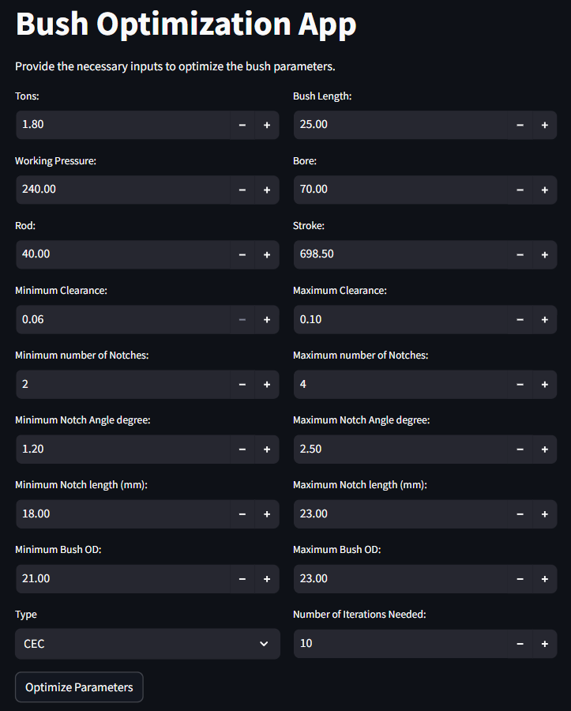
App Interface and Working
18 Fields to be entered, different Least counts for each.
All the minimum and maximum values can be set according to our wisdom and estimates.
ML model’s prediction largely depends on WP, Bore diameter, Stroke, Clearance, Notch Angle + 2 more.
Number of iterations ∝ Certainty of results`.
10 iterations take ≈ 11 seconds to process and produce optimal parameters.
Once every input parameters is decided, Optimize Parameters is clicked.

Slide 9
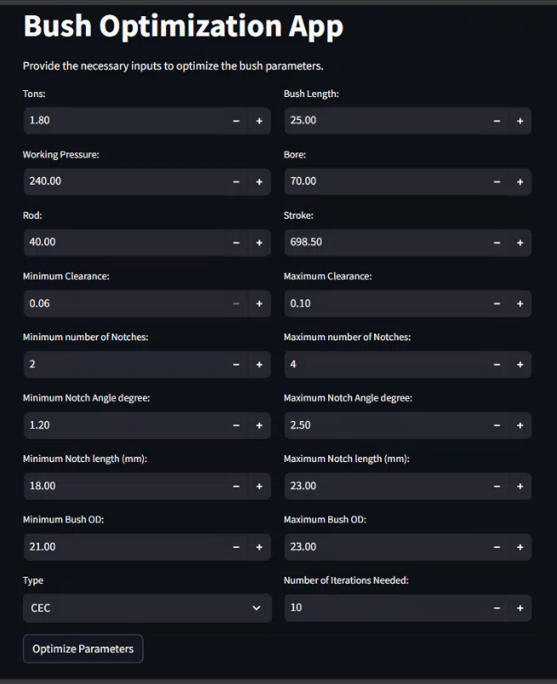
App Demonstration
After completion, we will get the Tonnage, Working Pressure, Bore , Type of Bush, Stroke, Bush Length, Clearance, Bush OD, Notch Angle, Notches, Notch length, Rod diameter.
First time right solution, i.e. optimally performing cushioning bush parameters.
Tested against several examples and validated.

Slide 10
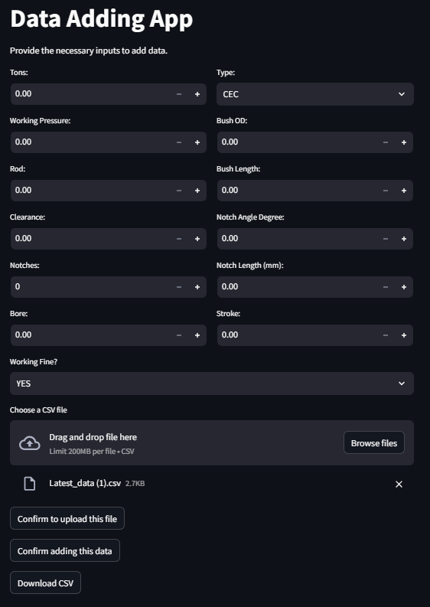
Data Adding app
Can be extended to excavators also.
No need to change the backend code.
Adding new data with a single click.
Mass upload feature(Can be used to make the correction).
Latest data can be exported to a CSV file(With feature names).
Will show “Data Saved Successfully” once we click Confirm.
Prepared Deployment document.

Slide 11
Distinctive Features of the App
User Friendly Interface.
Every parameter visible in a single window.
Editable entries, drop down menus, interactive UI.
Respective scales to increase or decrease value.
Customizable and easy to understand backend code.
Error handling

Slide 12
Pros of the approach
No need to refer previous drawings and data
Just feeding the input parameters and getting optimal bush parameters.
All the iterative and tedious tasks eliminated.
Design parameters estimation and fine-tuning, collectively can take as much as 12 hours on an average to be finalized. Using our Modified M-C model, we can finalize and get first time right solution in a matter of minutes.
Increased customer satisfaction.
Scaled Production.
Lower labor costs.
Decreased material wastage.

Slide 13
Challenges for approach
Model trained on Limited Mini-excavator models. Model can be made more robust and confident in its prediction with increase in data available.
Static data without simulation or experimental validation.
Testing is anyways inevitable.

Slide 14
2. Developing an Electronic Control Unit(ECU)
Overview of the approach
This approach focuses on regulating the speed of the piston and reduce it to a certain value even before the cushioning starts.
The main idea is to find the position of piston during its stroke and accordingly control the oil flow using a microcontroller.
But the main challenge is finding the position of piston( Difficult to use proximity sensors, strain gauges etc.).

Slide 15
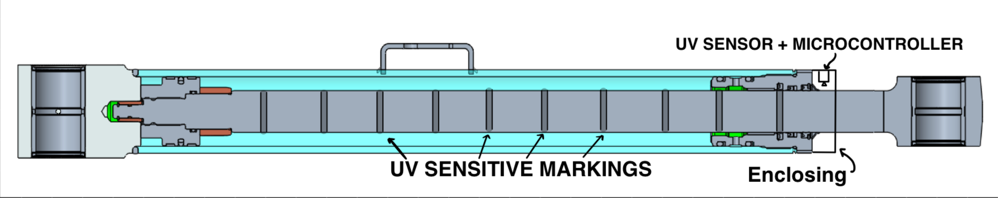
How to detect the position of the piston?
Using UV sensors to detect the position of the piston.
Mounting the UV sensor at the head end side with plastic enclosing.
Marking the piston rod with UV sensitive marks at uniform distances.
As the piston will be completing its stroke, the number of marks crossed and detected by UV sensors can be used to detect the position of piston.
Since now we have the position, we can start to decrease the oil ports opening using an Electronically variable orifice(EVO), controlled using microcontroller.
This would reduce the oil flow and hence the speed of moving piston.

Slide 16
Pros of the approach
We can reduce the speed of the piston to zero just before butting. Eliminating the need of cushioning bushes.
No pressure spikes.
Prolonged life of cylinders.
Decreased material cost.
Universal cushioning bush for every cylinder.
Lower labor cost.
All the iterative and tedious tasks eliminated.
Increased customer satisfaction.
Scaled Production.

Slide 17
Challenges of the approach
Extra component mounting and complicated system.
Marking mechanism yet to be discovered.
Regular maintenance for smooth functioning.
Complex training for manufacturers.
Cushioning mechanism failure if faced component failure.
Power supply needed(either through battery or customer’s machine).

Slide 18
QnA

Slide 19
Thank You for Your Time

Slide 20
Similarities between Modified M-C model and Monte Carlo Simulations:
Modified M-C model | Monte-Carlo Simulations
Random Sampling Random generation of Bush parameters. | Random Sampling Random sampling to generate input variables based on defined distributions of input variable.
Repetition Repeated iterations during the optimization process and cross-validation to explore different parameter samples and assess Bush performance. | Repetition Repeats simulations many times to explore a wide range of possible outcomes.
Statistical Analysis Aggregates results from multiple iterations to predict the best working parameters. | Statistical Analysis Analyzes aggregated results to estimate probabilities, expected values, variances, and other statistical measures.

